Slide 1

The Ardumine
Arduino Powered Bomb and Landmine Detector and Diffuser
BY
K.Yogitha
GUIDE
Dr Mohammed Aneesh, B.E., M.Tech., Ph.D., Assistant Professor, Department of ECE

Slide 2
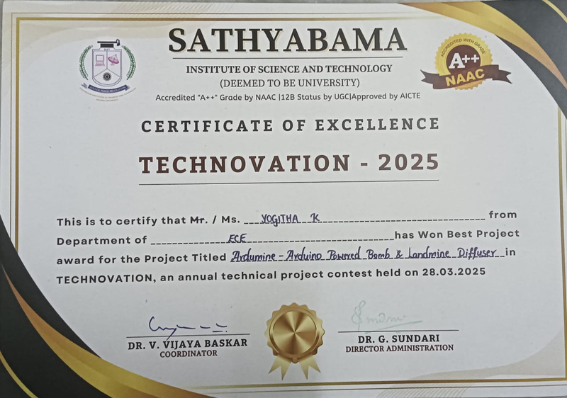
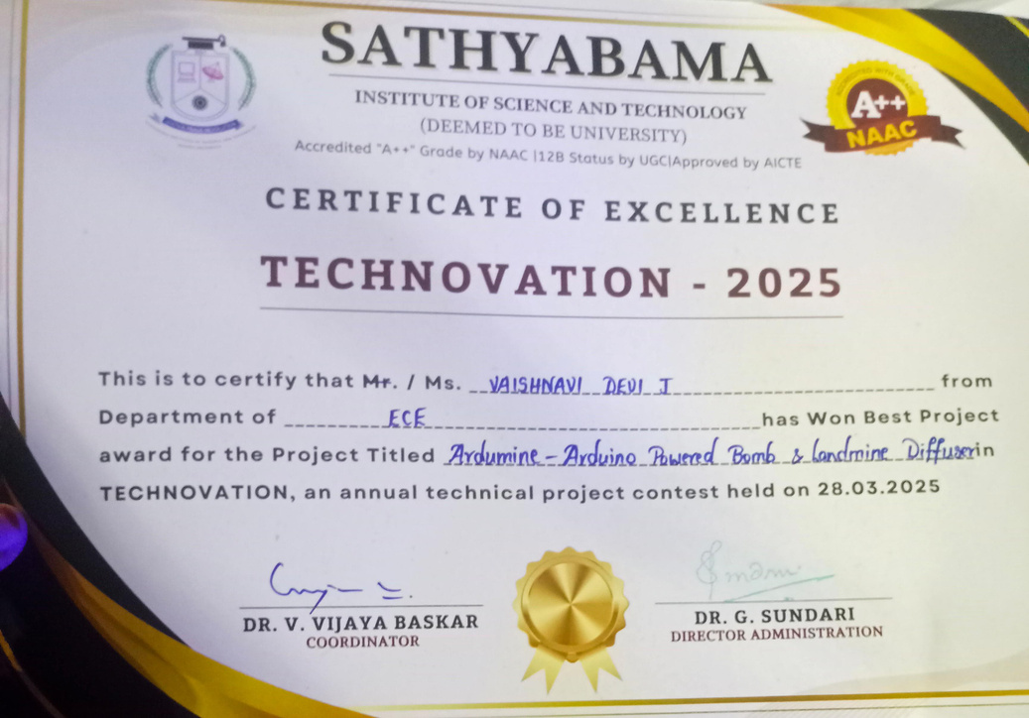
🏆 Best Project Award – Technovation 2025
We participated in the Technovation 2025 competition conducted by our college and won the Best Project Award for our innovative solution.

Slide 3
ABSTRACT
This project is an Arduino-based robot designed to detect and safely diffuse bombs and landmines.
It uses sensors to detect explosives and a robotic gripper to handle and diffuse them from a safe distance.
An ESP32 camera streams live video, and GPS tracks the exact location of any threats.
Toxic gas sensors provide extra safety, and a belt drive system allows movement on rough terrain.
Built for low cost and easy operation, this robot enhances safety for military and humanitarian work.

Slide 4
INTRODUCTION
Focuses on developing an Arduino-based robotic system for bomb diffusion and landmine detection.
Integrates various sensors to locate explosives and detect toxic gases.
Arduino microcontroller manages real-time data processing and controls the robotic gripper.
Includes GPS for accurate location reporting of detected threats.
Live-streaming camera provides remote monitoring capabilities.
Equipped with a belt-drive system to navigate rough terrains effectively.
Aims to be cost-effective, easy to use, and adaptable to diverse environments.

Slide 5
LITRETURE SURVEY
Si No | Title of the Project | Year | Author(s) | Description
1 | Development of an Autonomous Landmine Detection Robot | 2018 | A. Kumar, R. Singh | This study presents a robot equipped with ground-penetrating radar and metal detectors for landmine detection.
2 | Arduino-Based Landmine Detection System | 2019 | S. Johnson, L. Baker | Describes the implementation of an Arduino-controlled landmine detection system using metal detectors.

Slide 6
3 | Design and Implementation of a Robotic Arm for Bomb Disposal | 2020 | M. Davis, T. Lee | Focuses on designing a robotic arm controlled by an Arduino for the safe disarmament of detected explosives.
4 | Real-Time Data Processing for Explosive Detection Using Arduino | 2021 | P. Wang, J. Smith | Explores the use of Arduino for real-time data processing in explosive detection systems.
5 | Multi-Sensor Integration for Enhanced Bomb Detection | 2022 | K. Patel, D. Gupta | Discusses the integration of various sensors, including metal detectors and ground-penetrating radar, for improved detection accuracy.

Slide 7
PROBLEM STATEMENT
No GPS for precise location tracking.
Lacks toxic gas detection for environmental safety.
Unique combination of landmine and bomb detection with few existing references.
Limited range due to basic communication system.
Requires manual control, lacking full autonomy.

Slide 8
AIM & OBJECTIVE
Develop a robot to safely detect, locate, and diffuse bombs and landmines to reduce human risk
Equip the robot with a metal detector for accurate explosive detection
Enable remote handling with a robotic gripper for safe diffusion
Provide live video streaming and GPS tracking for real-time visuals and location
Design the robot for versatile use, including surveillance and archaeological exploration

Slide 9
METHODOLOGY
Assemble the robot with a metal detector, gripper, ESP32 camera, and other essential components.
Program the robot for remote control, integrating RF communication for safe operation at a distance.
Calibrate the metal detector to accurately locate bombs and landmines in various terrains.
Set up the live video stream with the ESP32 camera to provide real-time visuals to the operator.
Test the robot's movement, detection, and diffusion capabilities in controlled environments to ensure safe and effective performance.

Slide 10
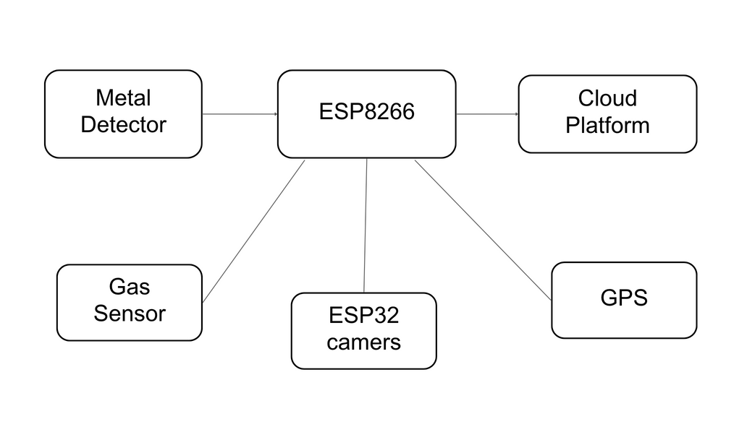
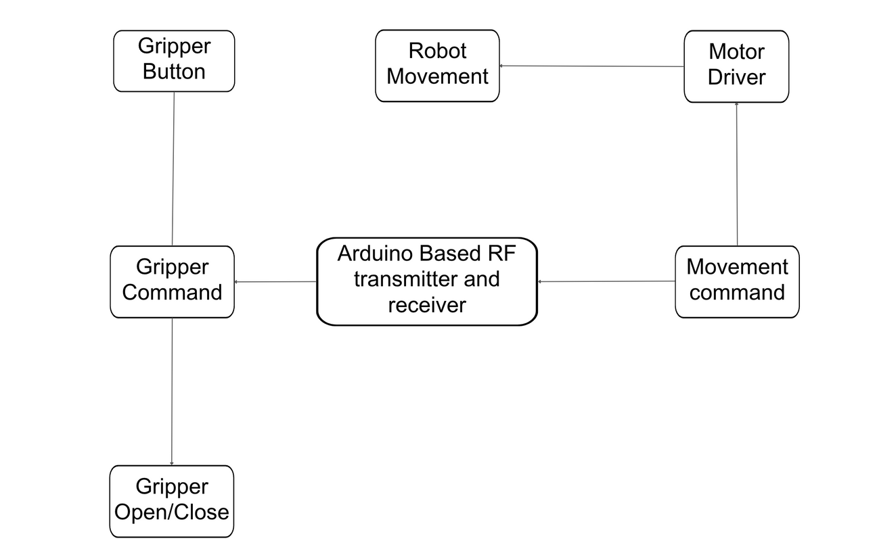
BLOCK DIAGRAM
IOT Functions
Mobility Control

Slide 11
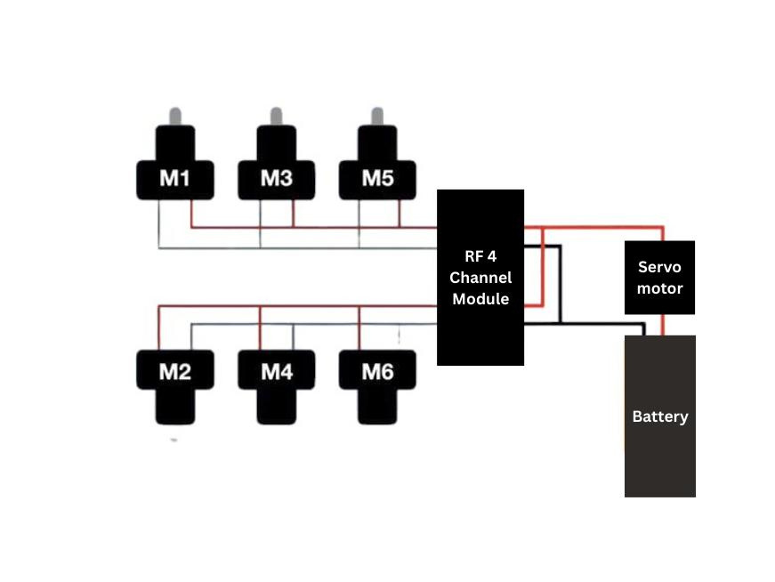
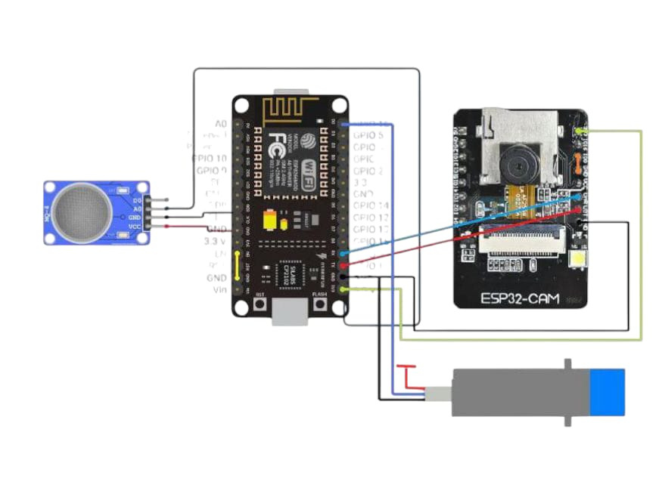
CIRCUIT DIAGRAM
Software Control
Movement Control

Slide 12
EXSISTING SYSTEM
•High risk for bomb disposal personnel
•Frequent injuries and fatalities during bomb defusal operations
•Limited protection for bomb disposal squads
•Manual bomb detection and disposal
•Use of handheld tools and equipment
•Direct exposure to potential explosions and hazardous materials
•Dependence on human expertise and presence on-site

Slide 13
PROPOSED SYSTEM
Additional Sensors: Installation of a gas sensor for detecting chemical gases in the air
Enhanced Surveillance: Camera for comprehensive monitoring of surroundings
Multi-Detection Capabilities: Sensors for detecting landmines, bombs, and chemical content
Improved Safety: Minimise risk to human life by automating hazardous tasks
Provides real-time data and visual feedback to operators
Robotic gripper Functionality: Gripper used to disconnect bomb wirings Controlled remotely via a controller
GPS Integration: GPS system to identify exact location of bombs or landmines Sends coordinates to the controlling device for precise localization

Slide 14
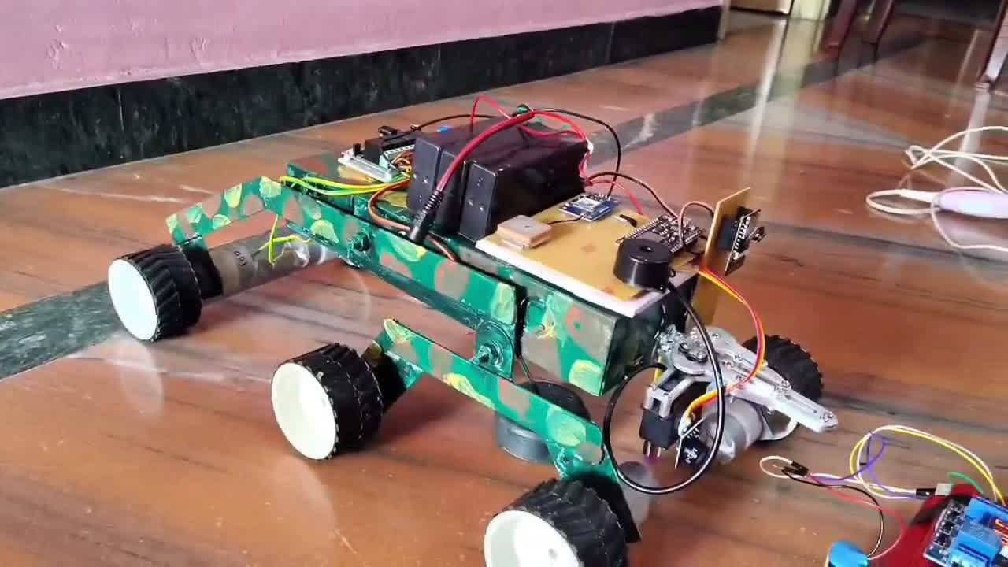
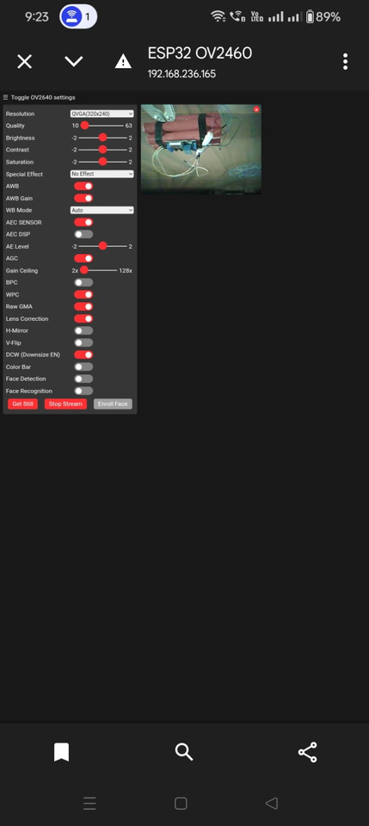
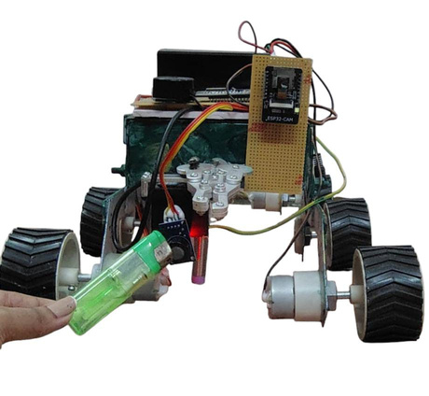
OUTPUT
Bomb diffusion
Detects and diffuses bombs and landmines.
Remote operation
RF control ensures operator safety.
Live video
Video streaming enhances disposal efficiency.

Slide 15
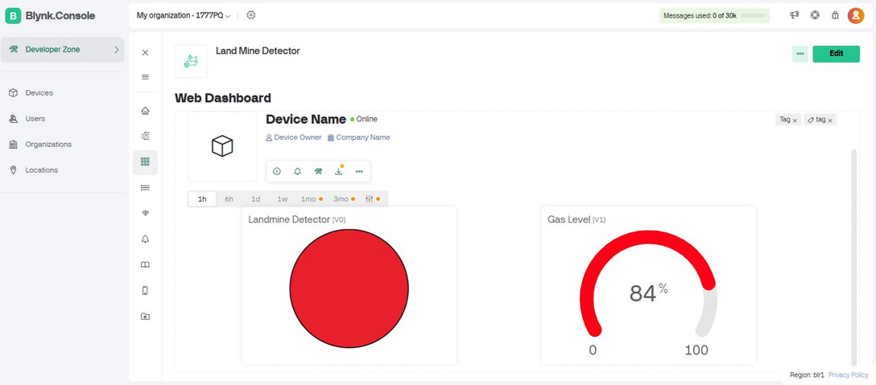
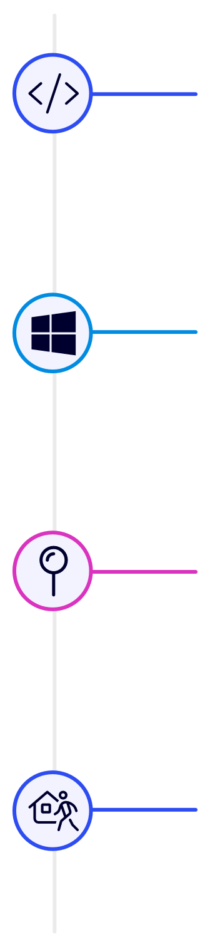
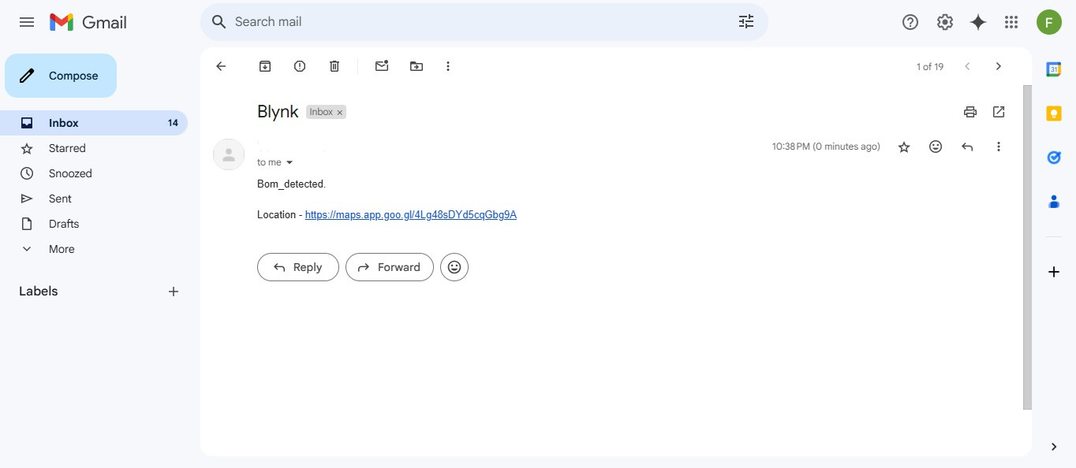
Software & User Interface
Arduino IDE
Programming the Arduino microcontroller and ESP32 module.
Custom GUI
User-friendly interface, real-time data to check the exact values of toxic gas and detect landmine.
Mapping Software
GPS data creates detailed maps and send the user the exact location of the explosives.
Remote Control
Control system from a safe distance (100m).

Slide 16
RESULT
All essential components for the bomb and landmine detector and diffuser system have been gathered.
The foundational code has been developed and compiles without issues in the IDE.
This marks a significant milestone in the project.
Next steps include integrating the components, uploading the code and running project.
The progress so far gives confidence in the project’s potential for enhancing safety and security.

Slide 17
CONCLUSION
The robot detects and diffuses bombs and landmines, reducing human risk.
Remote operation via RF ensures operator safety.
Metal detector, robotic gripper, and live video improve bomb disposal efficiency.
GPS enables accurate location tracking of explosive threats.
Toxic gas detection adds safety in hazardous environments.
The robot has potential for use in surveillance and archaeology.

Slide 18

THANKYOU

